Slide 1


DAYANANDA SAGAR UNIVERSITY
SCHOOL OF ENGINEERING
Department of CSE(Artificial Intelligence & Machine Learning)
<TITLE OF THE PROJECT IN ALL CAPS>
Under the Supervision
Dr./Prof. <Guide Name>
Presented By:
Student Name (Student USN)
Student Name (Student USN)
Student Name (Student USN)
Student Name (Student USN)
DEPT OF CSE(AI&ML)., SOE-DAYANANDA SAGAR UNIVERSITY
Notes:
Title of the project
CSE Dept., SET-Jain University

Slide 2
Contents
Abstract
Introduction
Problem Statement
Literature Survey
Methodology
Action Plan
References
DEPT OF CSE(AI&ML)., SOE-DAYANANDA SAGAR UNIVERSITY

Slide 3
Abstract
Give only key points
Do not write paragraph
Why this work
What you plan to do
How will you do-Approach
What we can expect as result
DEPT OF CSE(AI&ML)., SOE-DAYANANDA SAGAR UNIVERSITY

Slide 4
Introduction
What is the current status
What you plan to do
Scope of the project
Assumptions
DEPT OF CSE(AI&ML)., SOE-DAYANANDA SAGAR UNIVERSITY

Slide 5
Problem Statement and Research Gap
A problem statement is usually one or two sentences to explain the problem your process improvement project will address.
A problem statement should include a user, a need/ pain point and a goal/ reason.
Eg:
  Problem: “Going to the video store requires fighting traffic, wandering the aisles, and waiting in long lines just to get a single movie.”
  Solution: “Netflix allows anyone to enjoy thousands of titles streamed directly to their home or delivered to their mailbox.”
DEPT OF CSE(AI&ML)., SOE-DAYANANDA SAGAR UNIVERSITY

Slide 6
Literature survey
Do not copy paragraphs from papers or your report
Can include a table like below or text form
Paper Title | Conference Name and year | Technology used | Results | What you infer
DEPT OF CSE(AI&ML)., SOE-DAYANANDA SAGAR UNIVERSITY

Slide 7
Methodology(Flow chart/Block Diagram of the proposed system)
Methodology will include data flows, flowcharts, data structures:
  System architecture
  Database design
  Brief mention of all the platforms, systems, services, and processes the product would depend on
  Brief description of relationships between the modules and system features
DEPT OF CSE(AI&ML)., SOE-DAYANANDA SAGAR UNIVERSITY

Slide 8
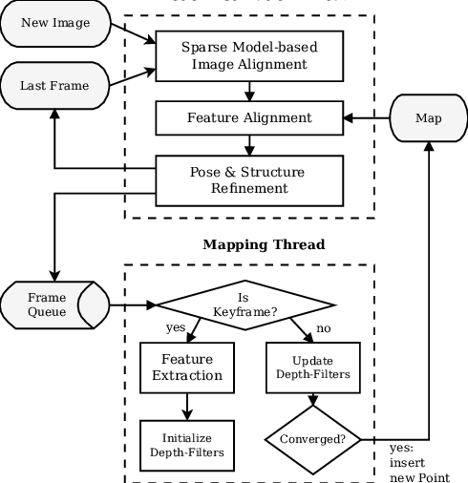
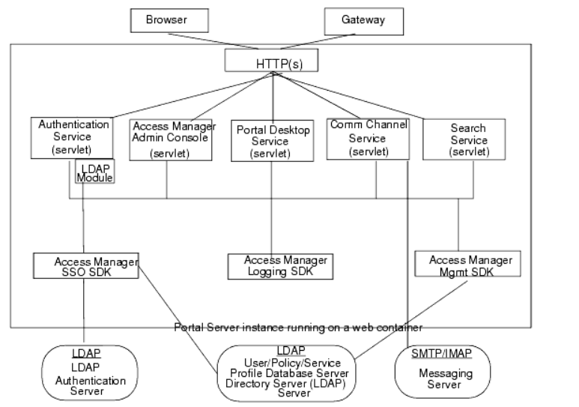
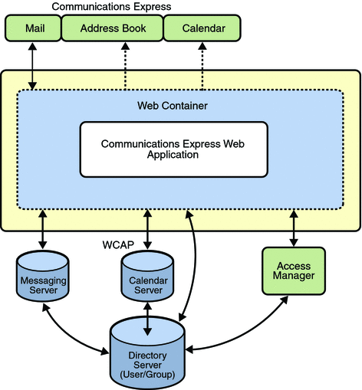
Methodology -examples
DEPT OF CSE(AI&ML)., SOE-DAYANANDA SAGAR UNIVERSITY

Slide 9
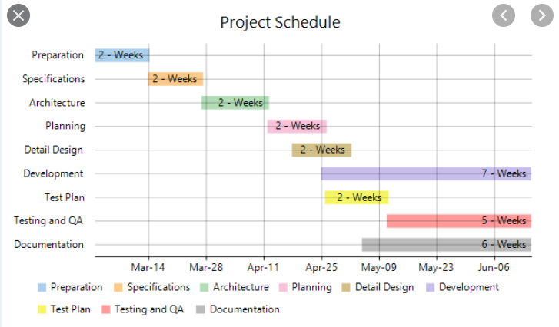
Action Plan
Please refer the below Action plan
DEPT OF CSE(AI&ML)., SOE-DAYANANDA SAGAR UNIVERSITY

Slide 10
References
List of all the papers that were referred in IEEE reference format-Example
[1] C. Hanieh , A. Amaya , G. Rafik and K. Frank,” Feature extraction for the differentiation of dry and wet cough sounds”, 2011 IEEE International Symposium on Medical Measurements and Applications, doi: 10.1109/MeMeA.2011.5966670.
[2] S. Matos, S.S. Birring, I.D. Pavord and H. Evans, Detection of cough signals in continuous audio recordings using hidden Markov models, 2006 IEEE Transactions on Biomedical Engineering, doi: 10.1109/TBME.2006.873548, vol. 53, pp. 1078 to 1083.
DEPT OF CSE(AI&ML)., SOE-DAYANANDA SAGAR UNIVERSITY

